Slide 1
Pay-per-request APIs
with x402 + stablecoins
$ curl -i https://the-future.org/api
HTTP/1.1 402 Payment Required
UCD Workshop v2 · < 2 hours · zero real money
presented by Kostas Apostolopoulos
// testnet only. no fiat was harmed in the making of this workshop.
Notes:
[~30s] Welcome, quick intro of yourself. Say: today you build an API that charges per request, and a client that pays it automatically. No sign-ups, no API keys, no credit cards. Point at the curl line: by the end, getting a 402 back will be the normal, happy path. Reassure: everything runs on a testnet. The money is fake, so nobody can lose anything. Transition: before theory, get your Codespace booting, because it takes a couple of minutes.

Slide 2
// boot sequence
[1] github.com/kgapos/ucd-workshop-2
[2] codespaces.new/kgapos/ucd-workshop-2 > Create Codespace
[3] Yes, I trust the authors - mostly harmless 🤙
[4] Terminal › New Terminal
// it takes a couple of minutes. talk to you meanwhile.
~/ucd-workshop-2
0x01
Notes:
[~1 min] Part 0. Keep this slide up until most hands are done. Do: everyone opens github.com/kgapos/ucd-workshop-2, clicks the Open in GitHub Codespaces button, then Create codespace. Wait for the files to appear, then approve the trust prompt. That is when dependencies install. Open a terminal: Terminal, New Terminal. Cost question will come up: a personal account gets about 60 hours a month free on this machine size. Stuck? No GitHub account or Codespaces greyed out: they can pair with a neighbour. Transition: while it builds, a bit of history.

Slide 3
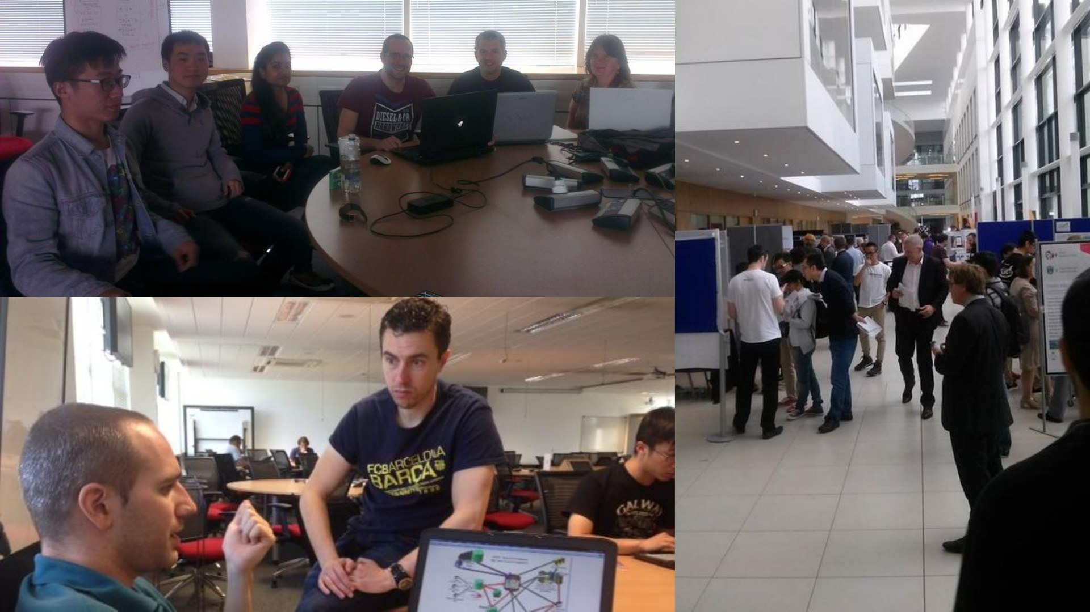
// $ whoami
Kostas
Apostolopoulos
ex UCD CompSci student
ex Head of NodeOps @vechain.org
now Principal DevOps Engineer @plasma.org
~/ucd-workshop-2
0x02
Notes:
[~45s, while Codespaces build] Who am I. Point at the photos: these are from my own time at UCD as a CompSci student, same building, same late nights, and a poster session in the atrium. Career in one breath: Head of NodeOps at VeChain, now Principal DevOps Engineer at Plasma. Transition: and this is not my first workshop here.

Slide 4
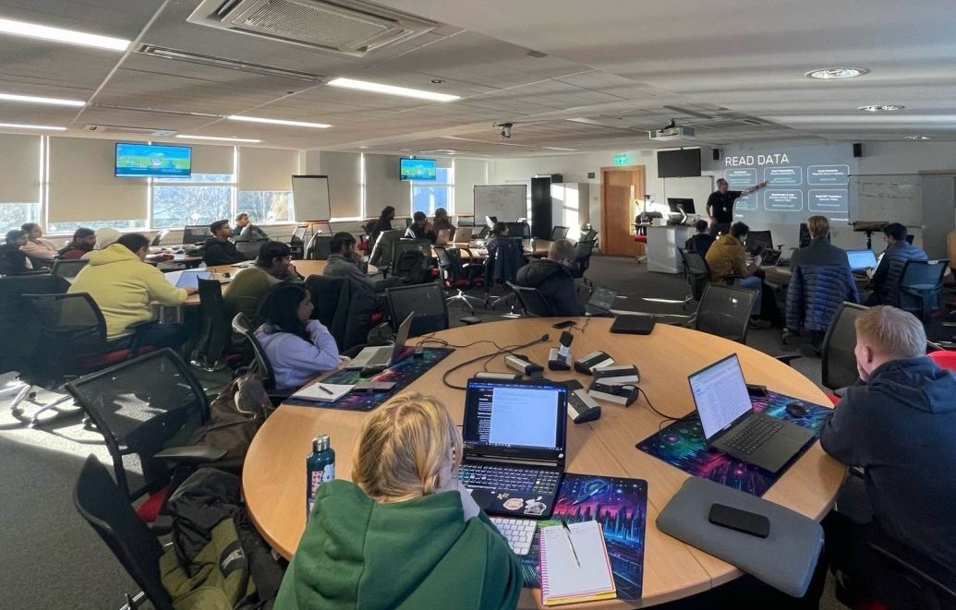
// previously, at UCD
2025 · AI agents on the blockchain
https://github.com/ucd-workshop
agents could read the chain
agents could talk about it
agents could not pay for anything
v2: give them a wallet and x402
~/ucd-workshop-2
0x03
Notes:
[~45s] Last year, same rooms: we built AI agents on top of the VeChain SDK and ElizaOS. They could read blocks, balances and transfers, and chat about what they found. Code is still at github.com/kgapos/ucd-workshop. The catch: the moment an agent wants to do something useful in the world, it hits a paywall. Data feeds, APIs, compute, other agents. It cannot sign up for an account, cannot pass a captcha, and nobody gives it a credit card. So agents were smart but broke. This year is the sequel: we give programs and agents a wallet, and teach HTTP how to ask for money. Transition: which starts with a status code nobody has used for 29 years.

Slide 5
HTTP/1.1, 1997
402
Payment Required
status: “reserved for future use”. for 29 years 🫣
~/ucd-workshop-2
0x04
Notes:
[~45s] Ask the room: who knows 404? 500? 418, I am a teapot? Now, who has ever seen a 402? Say: HTTP has had a status code for payments since 1997. The spec reserved it for future use. For almost thirty years nobody agreed what a client should actually do when it got one. So payments ended up happening around HTTP, not inside it: accounts, keys, cards, subscriptions. Transition: here is what buying one API call looks like today.

Slide 6
// buying one API call
legacy.exe
x402
sign up
GET /fortune
verify email
← 402 + price
credit card
sign + retry
API key
← 200 OK
$29/month plan
a key pair. that’s it.
~/ucd-workshop-2
0x05
Notes:
[~45s] Left: the usual dance to use a paid API. Five steps before your first request, and most of them need a human. Right: x402. Ask, get told the price, sign, retry, done. One round trip extra. Key point: the only credential is a key pair. A program can hold one, so programs and AI agents can pay without a human filling in forms. x402 is an open protocol, started by Coinbase, now an open foundation. Not tied to one company or one chain. Transition: let us trace one request in detail.

Slide 7
// one paid request, traced
hop | payload
client → server | GET /fortune
server → client | 402 + PAYMENT-REQUIRED
client | signs off-chain. free.
client → server | GET /fortune + PAYMENT-SIGNATURE
server → facilitator | verify, then settle
facilitator → chain | USDC transfer, pays gas, ~2s
server → client | 200 OK + PAYMENT-RESPONSE
~/ucd-workshop-2
0x06
Notes:
[~1.5 min] The whole protocol on one slide. Walk it row by row. 1. Client asks for /fortune like any normal request. 2. Server answers 402 with a PAYMENT-REQUIRED header: price, token, network, and who to pay. Base64 JSON; they will decode it themselves in Part 2. 3. Client signs a payment authorisation with its private key. Local, off-chain, free. 4. Client retries the same request with a PAYMENT-SIGNATURE header. 5. Server hands it to the facilitator: verify it, then settle it. 6. Facilitator submits the USDC transfer on-chain and pays the gas. About 2 seconds on Base. 7. Server returns 200, the content, and a PAYMENT-RESPONSE receipt with the transaction hash. Point out: the client never sends a blockchain transaction and never needs ETH for gas. Transition: so who is this facilitator, and should you trust it?

Slide 8
// the facilitator
trusted for liveness.
not with your money.
can
cannot
submit your signed transfer
change the amount
pay the gas
change the recipient
refuse to settle
reuse it after 5 minutes
EIP-3009 transferWithAuthorization: exactly 0.001 USDC, to this address, for 5 minutes.
~/ucd-workshop-2
0x07
Notes:
[~1 min] The facilitator is a helper service the server talks to. Two jobs: verify and settle. What the client signs is an EIP-3009 transferWithAuthorization: exactly this amount, to this address, valid for a few minutes, with a one-time nonce. So the facilitator can submit it and pays the gas, but it cannot change the amount, redirect it, or replay it. Worst case it refuses or goes down. Trusted for liveness, not custody. Today we use a class facilitator on my homelab, facilitator.kgapos.com, because the public one struggles with 40 people at once. Anyone can run one. Challenge 12 asks them to, and to think about what a dishonest one could do. Transition: why stablecoins and not, say, a credit card?

Slide 9
// why machines want stablecoins
$0.001 == $0.001
a stable price tag
1000
base units = a tenth of a cent
~2s
final. no chargebacks.
0 accounts
a key pair is enough
if (worth_it) pay()
money is just a signed message
// trade-offs: public ledger · lose the key, lose the funds · issuers can freeze
~/ucd-workshop-2
0x08
Notes:
[~1 min] Five reasons, one line each. Stable: a price of a tenth of a cent stays a tenth of a cent. A volatile token makes pricing an API a guessing game. Tiny: USDC has 6 decimals, so $0.001 is 1000 base units. Card fees, around 30 cents plus a percentage, kill anything under a few cents. Fast and final: about 2 seconds, no chargebacks. No accounts: a program needs a key pair, not a bank account or a contract with every provider. Programmable: a payment is just a signed message, so code decides when and how much to pay. Be honest about the trade-offs (amber line): every payment is public, lose the key and you lose the funds, and the issuer can freeze addresses. Good discussion material. Transition: where all this runs today.

Slide 10
// playground: Base Sepolia
84532
2s
3009
$0
chain id, an Ethereum L2 testnet
per block
EIP-3009 USDC from Circle
real value. break things freely.
every move is public: sepolia.basescan.org
// you are mine for only 5 more slides
~/ucd-workshop-2
0x09
Notes:
[~30s] Base Sepolia: a public Ethereum layer-2 testnet, network id eip155:84532. Why this one: x402 supports it, Circle's testnet USDC on it supports EIP-3009, blocks every 2 seconds, and a public explorer. The tokens are worth nothing, so break things freely. Everything is public: you will open your own payments on sepolia.basescan.org and see who paid the gas. Transition: here is the plan for the next two hours.

Slide 11
// the plan
0
open the Codespace
1
mint a wallet, get funded
2
put a price on your API
3
write a client that pays
4
buy from your classmates
5
stretch goals, challenges
AI tools welcome. they love the old v1 packages, so point them at @x402/*.
~/ucd-workshop-2
0x0A
Notes:
[~45s] Six parts, all in the README. Work at your own pace. Parts 2 and 3 have TODOs in starter/server.js and starter/client.js, with hints under each part. Part 4 is the fun one: you buy from each other, and the board shows who earns the most. Safety net: about an hour in, I push the reference solution. git pull and you are unblocked. AI tools are welcome, but they tend to suggest the old v1 packages like x402-express. This repo uses the v2 packages under @x402. Point them at docs.x402.org. Raise a hand any time. Transition: first, the board.

Slide 12
ucd.kgapos.com
// the leaderboard
every API. every payment. live.
~/ucd-workshop-2
0x0B
Notes:
[~20s] Do: open ucd.kgapos.com on the projector and leave it there for the rest of the session. Say: keep it open in a tab. It lists every registered API, whether it is up, paid requests, USDC earned and your balance. It is also how I find your address to send you testnet USDC. Labels to know: not funded means wait for me; port is private or port not forwarded means check the Troubleshooting table. Transition: let us get you on it.

Slide 13
// part 1: make a wallet
$ npm run wallet
$ npm run register -- https://ucd.kgapos.com
$ npm run balance
wait for 1 USDC + 0.0005 ETH. the instructor is the faucet.
// testnet key only. never put a real key in .env
~/ucd-workshop-2
0x0C
Notes:
[leave up ~5 min] Part 1. Three commands. npm run wallet: creates a private key, saves it to .env, prints your address. Testnet only, and .env is git-ignored. npm run register: sends your name, address and API URL to the board, and saves the class facilitator to .env. Instructor, once most names are on the board: npm run fund -- https://ucd.kgapos.com/apis.json --dry-run, then without --dry-run. Re-run it for late arrivals; nobody is paid twice. npm run balance: wait until it shows 1 USDC and 0.0005 ETH, then open the explorer link it prints. Then: everyone continues with Part 2 in the README at their own pace.

Slide 14
// side quests: 14, easy → expert
EASY
MEDIUM
find your payment on the explorer. who paid the gas?
dynamic pricing: /bulk?count=N
HARD
EXPERT
an agent that shops the whole board on a budget
run your own facilitator. what could a rogue one do?
full list: README › Challenges
~/ucd-workshop-2
0x0D
Notes:
[show when the first people finish Part 4, ~30s] Finished early? Fourteen challenges in the README, ordered easy to expert. Easy: find your own payment on the explorer and spot that the facilitator, not you, paid the gas. Medium: dynamic pricing, /bulk?count=N. Hard: an agent that shops the whole board without paying anyone twice. Expert: run your own facilitator and argue what a rogue one could and could not do. Also fun: challenge 13, a reseller that buys from a classmate and resells at a markup.

Slide 15
“Cypherpunks write code.”
Eric Hughes, A Cypherpunk’s Manifesto, 1993
> docs.x402.org
// find me
> github.com/x402-foundation/x402
web
kgapos.com
github
github.com/kgapos
> eips.ethereum.org/EIPS/eip-3009
x
x.com/kgapos
linkedin
linkedin.com/in/kgapos
> sepolia.basescan.org
// career opportunities for cracked engineers: plasma.org/careers
$ exit 0 // thank you!
~/ucd-workshop-2
0x0E
Notes:
[~1 min, last 5 minutes of the session] Wrap up. Do: show the board one last time and congratulate the top earners. The quote: from 1993, the idea that privacy and freedom online come from people building tools, not from asking permission. Today you wrote some code that moves money with no bank and no account. That is the spirit. Everything stays in the repo and the solution is on main. Codespaces stop when idle and they can delete them from github.com/codespaces. Find me at kgapos.com, or as kgapos on GitHub, X and LinkedIn. Plug: Plasma is hiring, plasma.org/careers, come talk to me after if you enjoyed today. Thank the hosts, UCD and Plasma. $ exit 0.

